Slide 1
Testing for Cognitive Bias in AI Systems
Peter Varhol, Technology Strategy Research

Slide 2
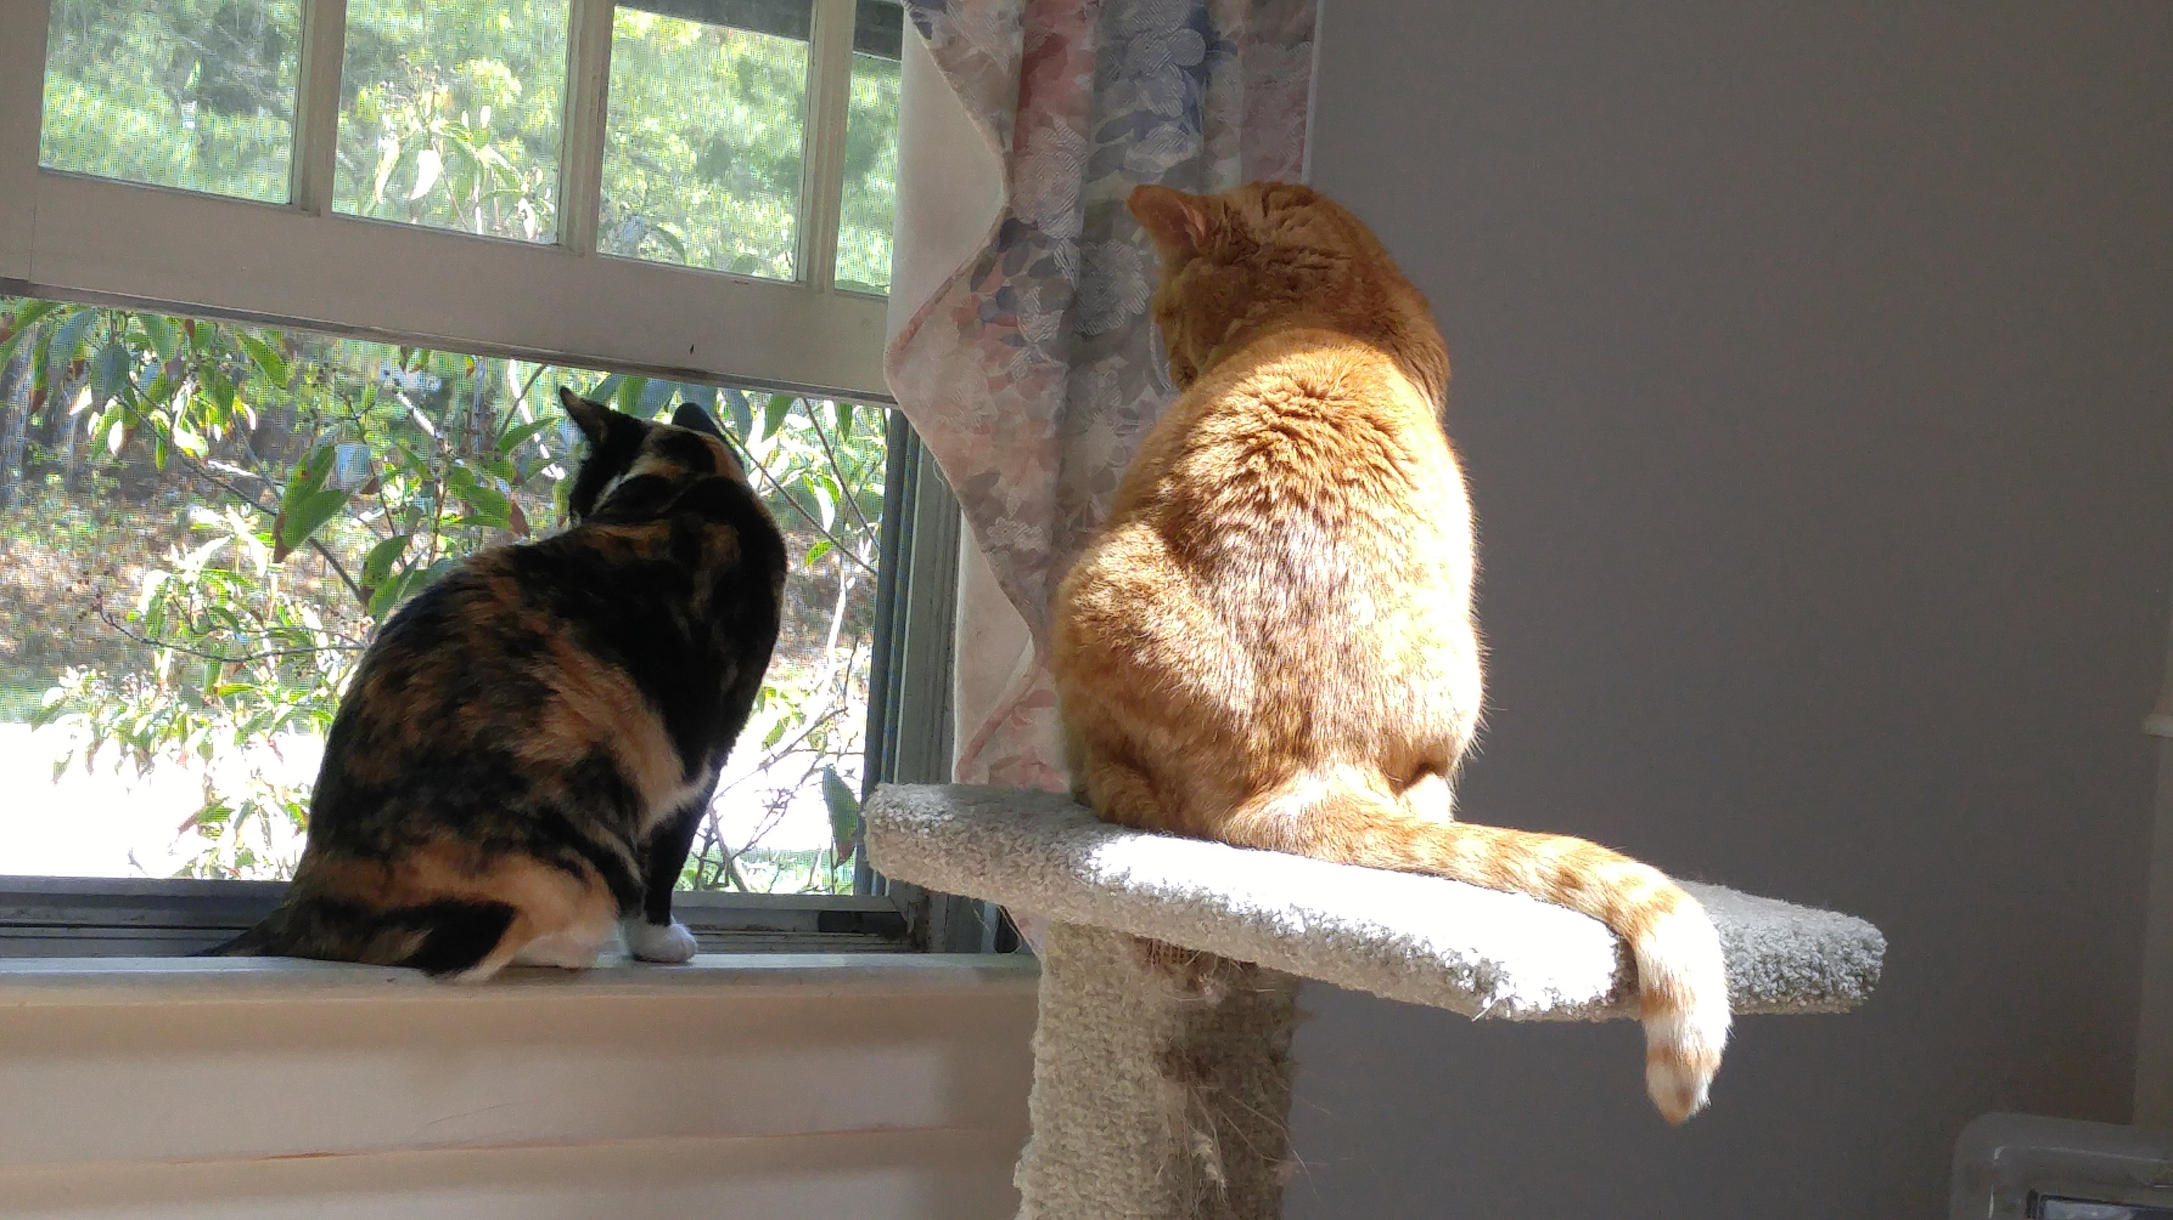
About Me
International speaker and writer
Degrees in Math, CS, Psychology
Technology communicator
Former university professor, tech journalist
Cat owner and distance runner
peter@petervarhol.com

Slide 3
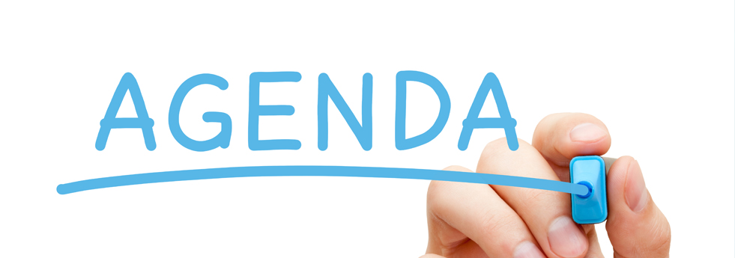
Agenda
What are machine learning and adaptive systems?
How can software possibly be biased?
How can we tell if they are biased?
Can we do anything?
Summary and conclusions

Slide 4
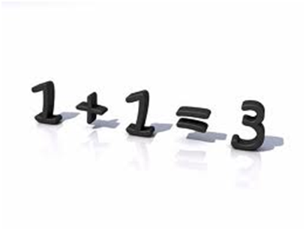
Machine Learning and Adaptive Systems
We are building a different kind of software
It never returns the same result
That doesn’t make it wrong
How can we assess if it’s correct?
How do we know if there is a bug?
How do we know if it’s biased?
Notes:
There is a type of software where having a defined output is no longer the case. Actually, two types. One is machine learning systems. The second is predictive analytics, or adaptive systems.

Slide 5
Bug vs. Bias
A bug is an identifiable and measurable error in process or result
Usually fixed with a code change
A bias is a systematic inflection in decisions that produces results inconsistent with reality
Bias can’t be fixed with a code change

Slide 6
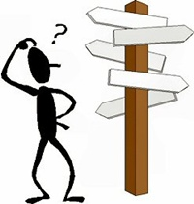
How Does This Happen?
The problem domain is ambiguous
There is no single “right” answer
“Close enough” can usually work
As long as we can quantify “close enough”
We don’t know quite why the software responds as it does
We can’t easily trace code paths
We choose the data
The software “learns” from past actions

Slide 7
How Can We Tell If It’s Biased?
We look very carefully at the training data
We set strict success criteria based on the system requirements
We run many tests
Most change parameters only slightly
Some use radical inputs
Compare results to success criteria

Slide 8
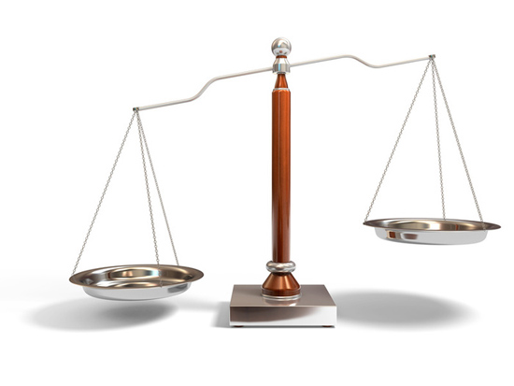
We Train Systems With Data
We know the input data and expected results
Input data is run through the algorithms and the results compared to actual results
The algorithms adjust parameters based on a comparison between algorithm and actual
What happens if the data systematically misrepresents the domain?

Slide 9
Amazon Can’t Rid Its AI of Bias
Amazon created an AI to crawl the web to find job candidates
Training data was all resumes submitted for the last ten years
In IT, the overwhelming majority were male
The AI “learned” that males were superior for IT jobs
Amazon couldn’t fix that training bias

Slide 10
Amazon Can’t Rid Its AI of Bias
So just train the AI with the candidates hired
Right?
No, because males were also hired in overwhelming numbers
Amazon hasn’t found a way to overcome this bias
So they stopped using the tool
Does all data have bias?

Slide 11
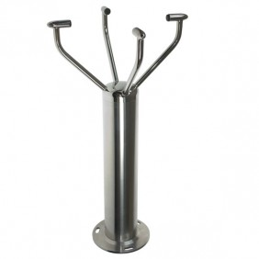
Many Systems Use Objective Data
Electric wind sensor
Determines wind speed and direction
Based on the cooling of filaments
Designed a three-layer neural network
Then used the known data to train it
Cooling in degrees of all four filaments
Wind speed, direction

Slide 12
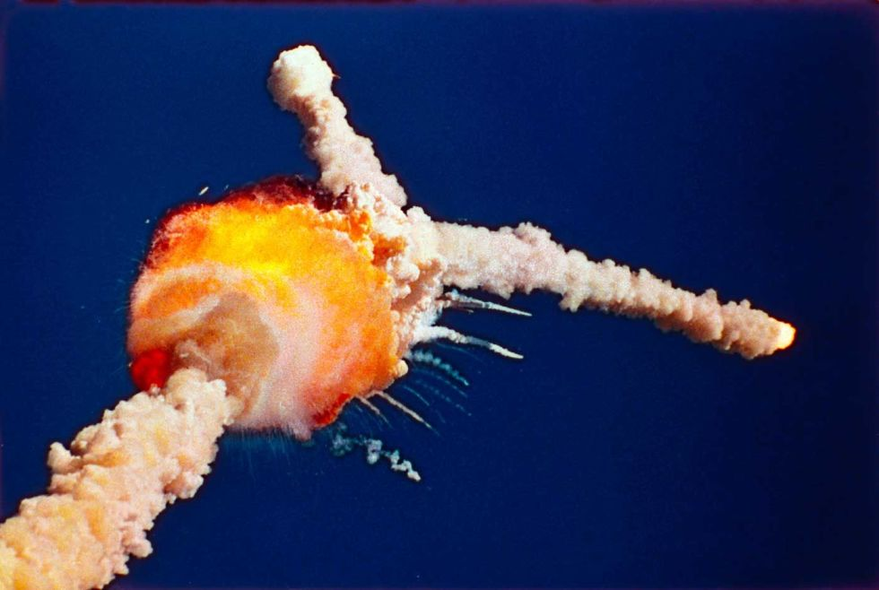
Can This Possibly Be Biased?
Well, yes
The training data could have been recorded in single temperature/sunlight/humidity conditions
Which could affect results under those conditions
It’s a possible bias that doesn’t hurt anyone
Or does it?
Does anyone remember a certain O-ring?

Slide 13
Where Do Biases Come From?
Data selection
We choose training data that represents only one segment of the domain
We limit our training data to certain times or seasons
We overrepresent one population
Or
The problem domain has subtly changed

Slide 14
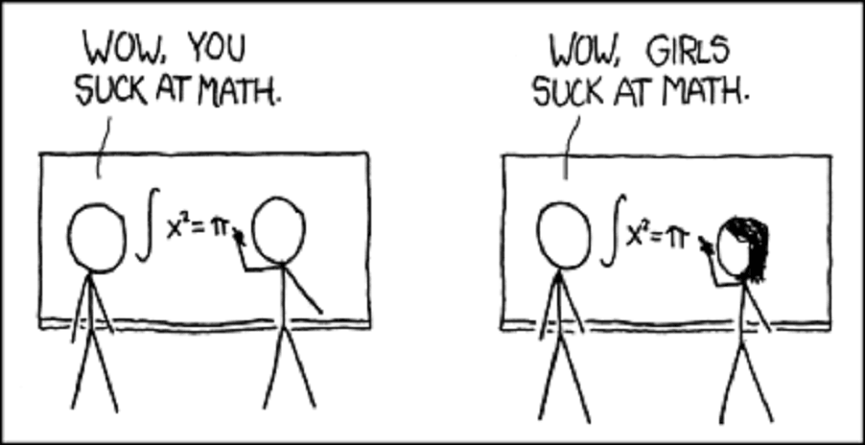
Where Do Biases Come From?
Latent bias
Concepts become incorrectly correlated
Correlation does not mean causation
But it is high enough to believe
We could be promoting stereotypes
This describes Amazon’s problem

Slide 15
Where Do Biases Come From?
Interaction bias
We may focus on keywords that users apply incorrectly
User incorporates slang or unusual words
“That’s bad, man”
The story of Microsoft Tay
It wasn’t bad, it was trained that way

Slide 16
Why Does Bias Matter?
Wrong answers
Often with no recourse
Subtle discrimination (legal or illegal)
And no one knows it
Suboptimal results
We’re not getting it right often enough

Slide 17
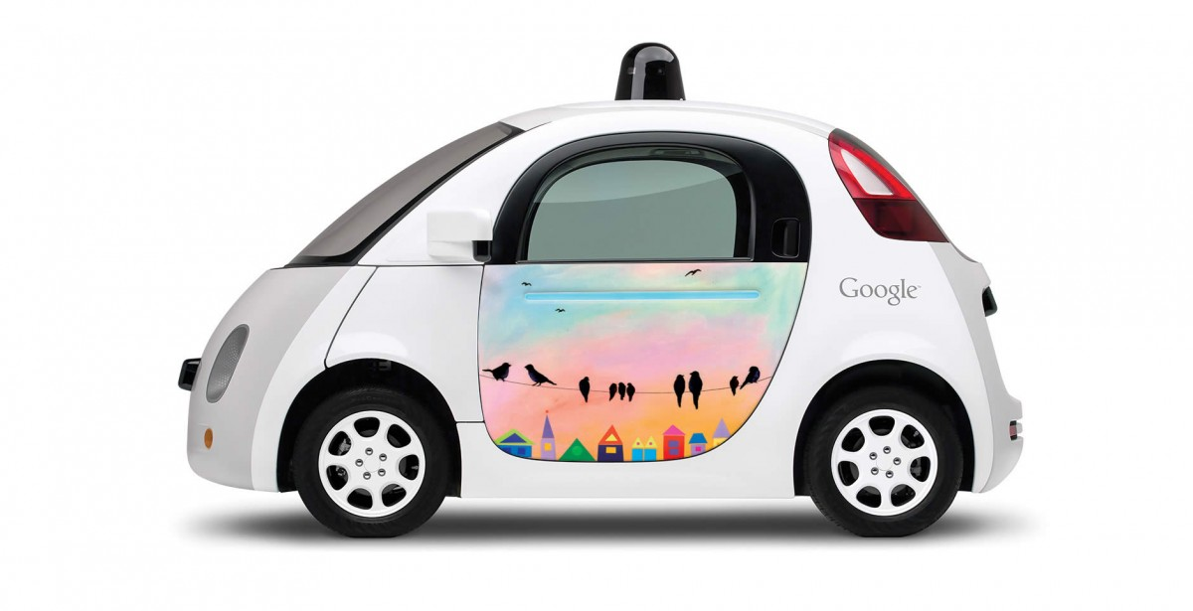
How Are These Systems Used?
Transportation
Self-driving cars
Ecommerce
Recommendation engines
Finance
Stock trading systems
HR
This is a scary one
Medicine
This is scarier
Notes:
These types of software are becoming increasingly common, in areas such as ecommerce, public transportation, automotive, finance, and computer networks. They have the potential to make decisions given sufficiently well-defined inputs and goals. In some instances, they are characterized as artificial intelligence, in that they seemingly make decisions that were once the purview of a human user or operator.

Slide 18
It’s Not Just AI
All software has biases
It’s written by people
People make decisions on how to design and implement
Bias is inevitable
But can we find it and correct it?
Do we have to?

Slide 19
Like This One
A London doctor can’t get into her fitness center locker room
The fitness center uses a “smart card” to access and record services
While acknowledging the problem
The fitness center couldn’t fix it
But the software development team could
They had hard-coded “doctor” to be synonymous with “male”
It was meant as a convenient shortcut

Slide 20
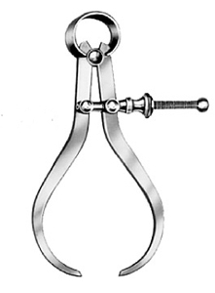
About That Data
We use data from the problem domain
What’s that?
In some cases, scientific measurements are accurate
But we can choose the wrong measures
Or not fully represent the problem domain
But data can also be subjective
We train with photos of one race over another
We train with our own values of beauty

Slide 21
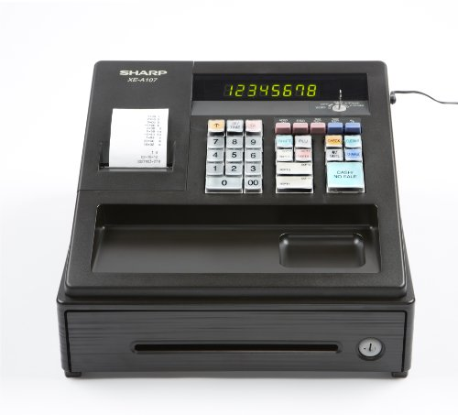
Another Example
Retail recommendation engines
Other people bought this
You may also be interested in that
They can bring in additional revenue
But they can be very wrong sometimes
The algorithms think we want to see what they show us

Slide 22
Where Bias Can Be Very Wrong
Brooks Ghost running shoes
Versus ghost costumes
Our data doesn’t take context into account

Slide 23
Challenges to Validating Requirements
What does it mean to be correct?
The result may be different every time
There is no one single right answer
How will this really work in production?
How do I test it for bias?
Notes:
How do you test this? You do know what the answer is supposed to be, because you built the network using the test data, but it will be rare to get an exactly correct answer all of the time.
The product is actually tested during the training process. Training either brings convergence to accurate results, or it diverges. The question is how you evaluate the quality of the network.

Slide 24
Possible Answers
Only look at outputs for given inputs
And set accuracy parameters
Don’t look at the outputs at all
Focus on performance/usability/other features
We can’t test accuracy
Throw up our hands and go home
We can’t easily define bias, let alone test for it

Slide 25
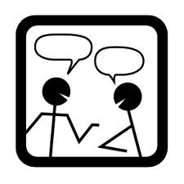
Testing Machine Learning Systems For Bias
Have objective acceptance criteria
Test with new data
Don’t count on all results being accurate
Understand the architecture of the network as a part of the testing process
Communicate the level of confidence you have in the results
Notes:
Have objective acceptance criteria. Know the amount of error you and your users are willing to accept.
Test with new data. Once you’ve trained the network and frozen the architecture and coefficients, use fresh inputs and outputs to verify its accuracy.
Don’t count on all results being accurate. That’s just the nature of the beast. And you may have to recommend throwing out the entire network architecture and starting over.
Understand the architecture of the network as a part of the testing process. Few if any will be able to actually follow a set of inputs through the network of algorithms, but understanding how the network is constructed will help testers determine if another architecture might produce better results.
Communicate the level of confidence you have in the results to management and users. Machine learning systems offer you the unique opportunity to describe confidence in statistical terms, so use them.
One important thing to note is that the training data itself could well contain inaccuracies. In this case, because of measurement error, the recorded wind speed and direction could be off or ambiguous. In other cases, the cooling of the filament likely has some error in its measurement.

Slide 26
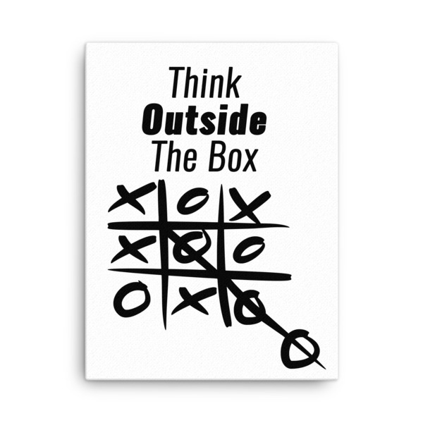
Gearing Up to Test
Think outside the box
Understand your users intimately
What will a user do?
Know the training data
Look for bias in the data
Write tests to exploit edge cases
Run many tests to look for trends

Slide 27
What is a Bug?
A mismatch between inputs and outputs?
It supposed to be that way!
Not every recommendation will be a good one
But that doesn’t mean it’s a bug
Too many wrong answers
Define too many
Define wrong

Slide 28
We Found a Bug, Now What?
The bug could be unrelated to the neural network
Treat it as a normal bug
If the neural network is involved
Determine a definition of inaccurate
Determine the likelihood of an inaccurate answer
This may involve serious redevelopment

Slide 29
Bias and Truth and AI, Oh My
All human decisions are biased in some way
Do we want human decisions, or do we want correct ones?
Human decisions come with human biases
Can we get those out of our software?
And will it be better if we do?
Even with bias, computer decisions may be better

Slide 30
A Larger Problem
What if we want the system to replicate how we would decide?
Irrespective of bias
We may accept bias if it is consistent
After all, humans are biased
This is a question with no easy answer in practice

Slide 31
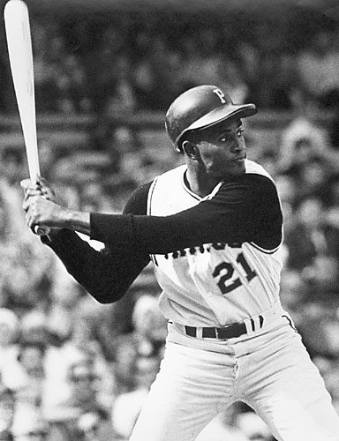
Delivering in the Clutch
Machines treat all events as equal
Humans recognize the importance of some events
And sometimes can rise to the occasion
There is no mechanism for code to do this
We could have data and algorithms to recognize the importance of a specific event
But the software cannot “improve” its answer
This is less a bias than an inherent weakness

Slide 32
The Human in the Loop
We don’t understand complex software systems
Disasters often happen because software behaves in unexpected ways
Human oversight may prevent disasters, or wrong decisions
Can we overcome human bias?
The problem is that machines respond too quickly
In many cases, there is not enough time for human oversight

Slide 33
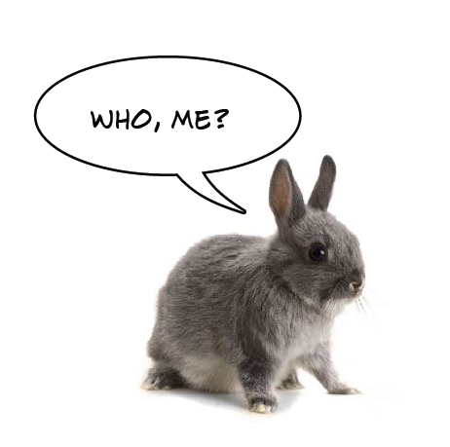
Objections
I will never encounter this type of application!
You might be surprised
I will do what I’ve always done
No, you won’t
My goals will be defined by others
Unless they’re not
You may be the one

Slide 34
Conclusions
You can’t make intelligence from code
Algorithms are thoughtless
“Learning” systems are what we program and train
No easy answer
If we choose the data, it will likely be biased
Recognize how your data fits into the problem domain
Notes:
You can’t make gold from lead, and you can’t make intelligence from code.

Slide 35
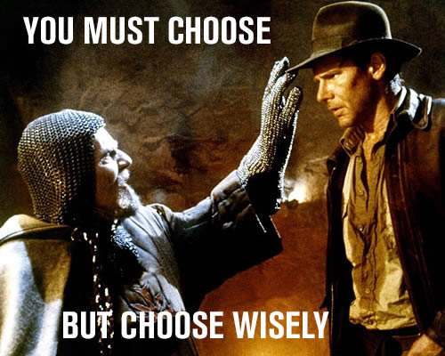

Slide 36
References
https://qz.com/989137/when-a-robot-ai-doctor-misdiagnoses-you-whos-to-blame/
https://qz.com/1089555/artificial-intelligence-programmers-are-trying-to-turn-code-into-intelligence-like-alchemists-tried-turning-lead-into-gold/
https://www.theatlantic.com/technology/archive/2017/09/saving-the-world-from-code/540393/
https://qz.com/work/1454396/amazons-sexist-hiring-algorithm-could-still-be-better-than-a-human/

Slide 37
The End
Peter Varhol
peter@petervarhol.com
@pvarhol

